Slide 1
Continuous probability distributions
Normal distribution
Standard normal distribution

Slide 2
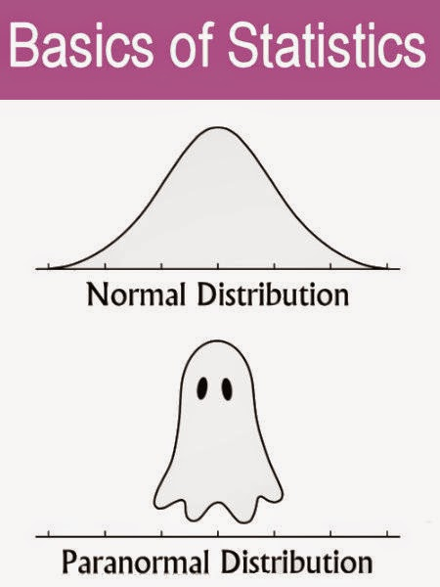
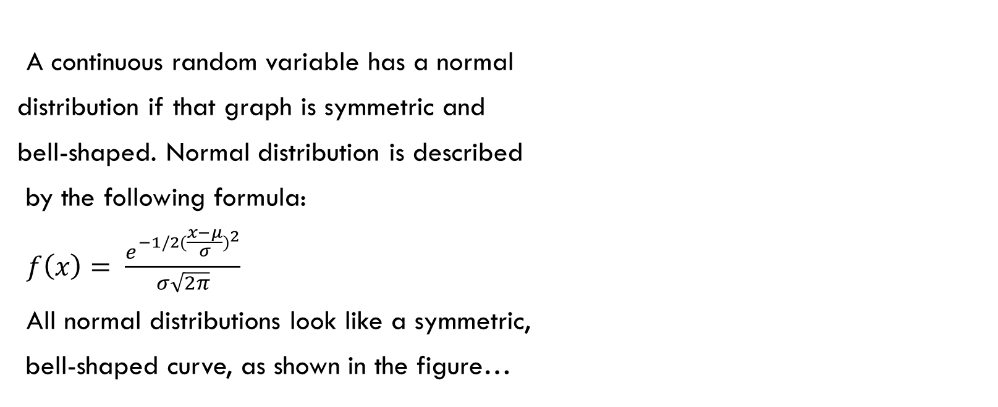
Normal distribution
A continuous random variable has a normal
distribution if that graph is symmetric and
bell-shaped. Normal distribution is described
by the following formula:
$f\left(x\right)= \frac{e^{−1/2{(\frac{x−μ}{σ})}^{2}}}{σ\sqrt{2π}}$
All normal distributions look like a symmetric,
bell-shaped curve, as shown in the figure…

Slide 3
Characteristics of normal distribution
Continuous distribution
Symmetrical distribution
Asymptotic to the horizontal axis
Unimodal
Total area under the
curve sums to 1.
Area to right of mean
is 1/2.
Area to left of mean is 1/2.
1/2
1/2

Slide 4
Comments
The graph of the normal distribution depends on two factors - the mean and the standard deviation.
The mean of the distribution determines the location of the center of the graph, and the standard deviation determines the height and width of the graph.
When the standard deviation is large, the curve is short and wide; when the standard deviation is small, the curve is tall and narrow.

Slide 5
Visualising the last comments
20
30
40
50
60
70
80
90
100
110
120

Slide 6
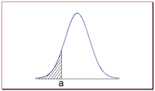

More about the normal distribution…
The normal distribution is a continuous probability distribution with the following properties:
- The total area under the normal curve is equal to 1.
- The probability that a normal random variable X equals any particular value is 0.
P(x = a) = 0

Slide 7
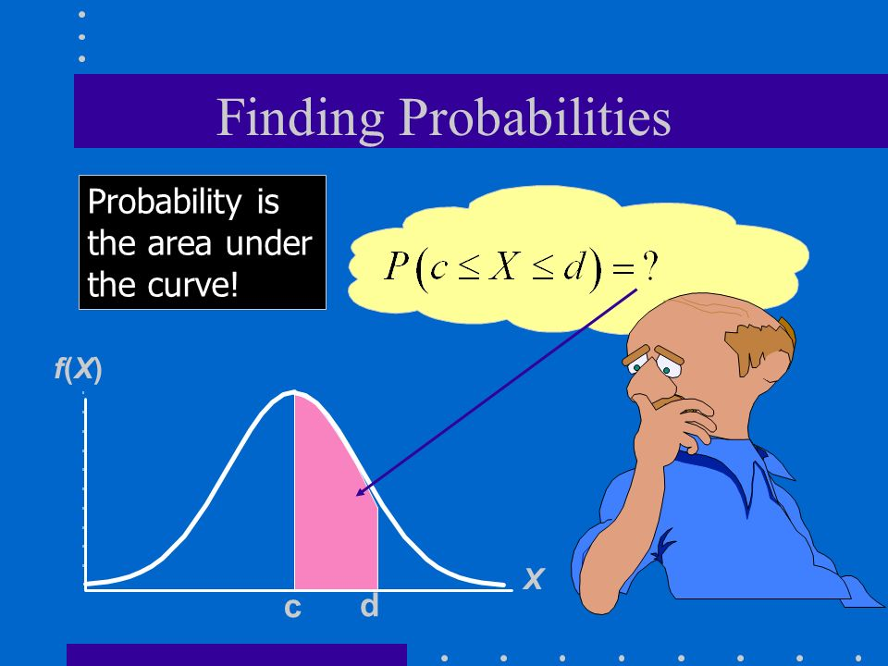
Keep this in mind!

Slide 8
- The probability that X is greater than a equals the area under the normal curve bounded by a and plus infinity (as indicated by the non-shaded area in the figure below).
- The probability that X is less than a equals the area under the normal curve bounded by a and minus infinity (as indicated by the shaded area in the figure below).

Slide 9
The standard normal distribution
What is it?
A normal distribution with
a mean of zero, and
a standard deviation of one
Z Formula
standardizes any normal distribution
Z Score
the number of standard deviations a value is away from the mean
Important!
The area under the curve represents probabilities.
The values on the horizontal axis represent values of the z - scores.

Slide 10
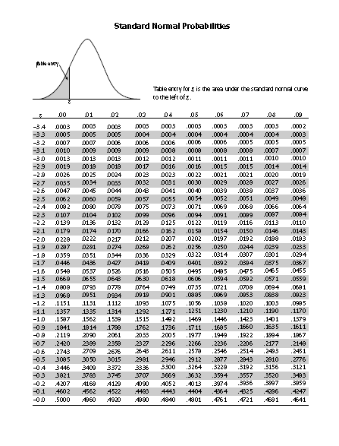
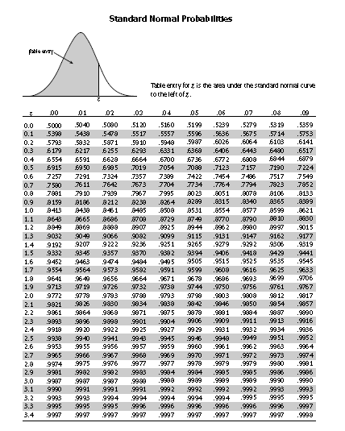

Slide 11
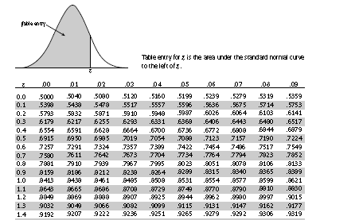

Consider a normally distributed variable z and find the probability for this variable to be between 0 and 1.43.
$P\left(0<z<1.43\right)$ = ?
Area to the left of 0 = 0.5
Area to the left of 1.43 = 0.9236
$P\left(0<z<1.43\right)$ = 0.9236 – 0.5
= 0.4236

Slide 12
Find the probability: a) Less than…

Slide 14

Find the probability b) Greater than…
$$P\left(z>0.84\right)=$$

Slide 16
Find the probability c) Between z₁ and z₂

Slide 18
Finding z- scores when given probabilities
Draw a bell-shaped curve, draw the centre line, and identify the region under the curve that corresponds to the given probability.
Locate inside the body of the table the probability that is closest to the given one.
Read the z - score.
Example:
Find the z- scores that bound the middle 95% of a normal distribution.

Slide 19
Determine percentiles
Find the 33rd percentile for the IQ scores with a mean of 100 and a standard deviation of 16.
Find the score representing the 90 th percentile for the IQ scores from question 1.

Slide 21
Find data values
Find the data value that corresponds to the 80th percentile for a normal distribution with a mean of 72 and a standard deviation of 13.

Slide 23

Application
It was found that the mean length of 100 parts was 20.05 with a standard deviation of 0.02 .
Find the probability that a part selected at random would have a length
(a) between 20.03 mm and 20.08 mm
(b) between 20.06 and 20.07
(c) less than 20.01 mm
(d) greater than 20.09 mm

Slide 26
Practice
1. The length of life of an instrument produced by a machine has a normal distribution with a mean of 12 months and standard deviation of 2 months. Find the probability that an instrument produced by this machine will last a) Less than 7 months. b) Between 7 and 12 months.

Slide 28
2. A radar unit is used to measure speeds of cars on a motorway. The speeds are normally distributed with a mean of 90 km/h and a standard deviation of 10 km/h. What is the probability that a car picked at random is travelling at more than 100 km/h?

Slide 30
3. A large group of students took a test in Physics and the final grades have a mean of 70 and a standard deviation of 10. If we can approximate the distribution of these grades by a normal distribution, what percent of the students a) Scored higher than 80? b) Should pass the test (grades≥60)? c) Should fail the test (grades<60)?

Slide 33
4. At a company, the amount of retirement savings employees invest per month was recorded. The data follows a normal distribution with a mean of $360 and a standard deviation of $22.30.
a) What is the probability of finding an employee who invests more than $400 per month?
b) What is the probability of finding an employee who invests between $350 and $420 per month?
c) Below what amount of investment will we find 75% of the employees’ investment?
d) What amount of investment is at the 90th percentile?

Slide 37
5. A population of packages have weights normally distributed with a mean of 5.7 kg and a standard deviation of 1.7 kg.
A) Find the value of the weight representing the 35th percentile
B) Find the value of the weight representing the 87th percentile

